Slide 1


Club Communications
RLI - Part 3
Notes:
Begin the session:
Introduce self
Describe format for the session
Talk about what materials are available and/or where they can be found

Slide 2
Goals:
Discuss
Discuss best practices for communicating to Rotarians
Develop
Develop a tool kit of different types of communication
Recognize
Recognize elements of effective communication
Reflect
Reflect on barriers to communication in clubs
Notes:
Review Session Goals, where this course fits into the Membership curriculum of RLI.
Refer to referenced materials and where to find them.
NOTE: The Facilitator Guide for this session diverges from the participant manual. All needed materials are provided to faculty to facilitate this updated session. The participant manual continues to provide a relevant resource for participants with thought provoking questions and activities. This is true for a handful of sessions and will be noted when it occurs. These manuals will be updated at the next printing.

Slide 3

How would you organize and develop a presentation for a club meeting?
Notes:
Present the question on the screen.
You are tapped to present a program at a club meeting. How do you organize your thoughts? Styles differ among individuals. What is your preferred?
Ask folks to unmute and raise their virtual hand to offer an idea.
Address variety of ways people prepare for a presentation.
Introduce the specific type of communications to be addressed in this session.
In this session, we will explore best practices for communicating INTERNALLY to club members and the Rotarian family. The session “Public Relations and Public Image” deals with communication to those outside the club – EXTERNAL Communications.
NOTE: There are seven (7) vignettes that comprise the basis of this session. The size of the group will determine the facilitation technique used. If there are seven or less in the group give each person a different “situation”. If there are more than 10 or 12, form partners or trios.

Slide 4

Internal Communications
You are club secretary.
You have had a family emergency
You did not get minutes sent out
You did not have time to tell club president
Message received from club president
Notes:
Introduce activity by giving instructions about how breakouts will be organized.
In you BREAKOUTS you and your partners will be able to choose a vignette. Each vignette is similar in that you are the secretary of our club, had a family emergency, did not get the minutes sent, and had not had time to inform the president. The message from the president is also the same in every vignette.
What IS different, is the method that was used to communicate that method. Your task is to identify the FEELING that the vignette elicits. How does this FEELING relate to the communication method used?
Form partners or trios in BREAKOUTS depending on the group size (there are 7 scenarios).
Identify spokesperson for each group and assign group number.
Access vignettes from Documents for Class section of My Event
Launch BREAKOUTS. Close BREAKOUT after 3-4 minutes.
Reconvene whole group and have spokespersons share their vignette, the feelings it invoked and how that relates to the communication method.
Give the rest of the group the opportunity to comment on what each group presented
Once all the groups have share, ask what method the folks feel was ideal in that situation and why.

Slide 5
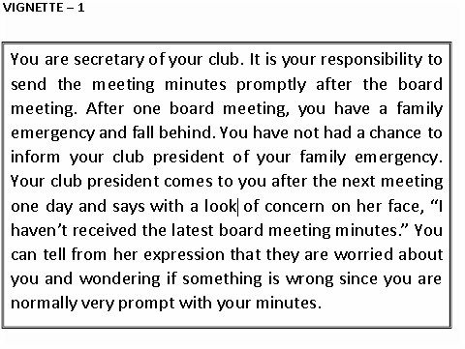
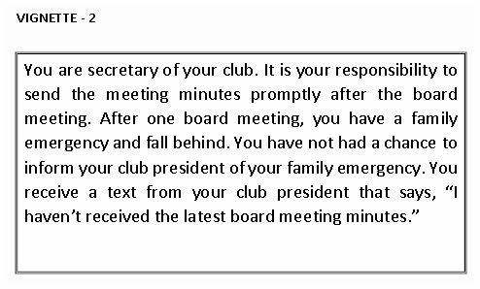
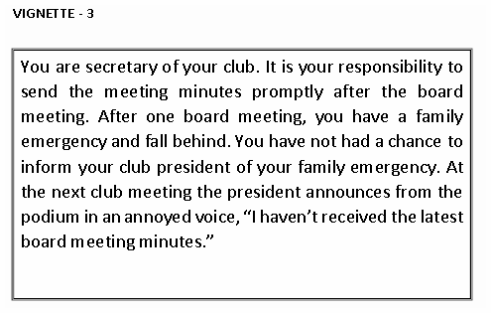
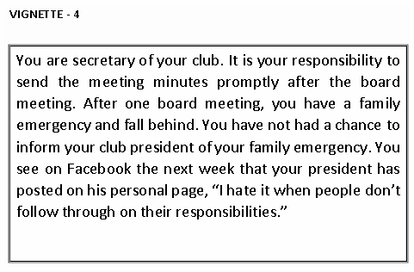
Notes:
Optional – Share this slide to breakouts

Slide 6


Rotary Leadership Communication Issues
Issues
  Want to serve on Board
  Deal with offensive remarks
Notes:
Introduce Rotary Leadership Communication Issues
There are many other situations that Rotary leaders face which require communication. We will consider two potential situations clubs face. Talk among your group about the matter and respond to the questions provided.
Divide the participants into two groups
Assign one group Vignette B and the other Vignette C.
Access Vignettes in My Event
Launch BREAKOUT and give groups 6-7 minutes to discuss the situation.
Reconvene whole group and have groups present their conclusions
Discuss how best to deal with these situations and others that arise in clubs.

Slide 7
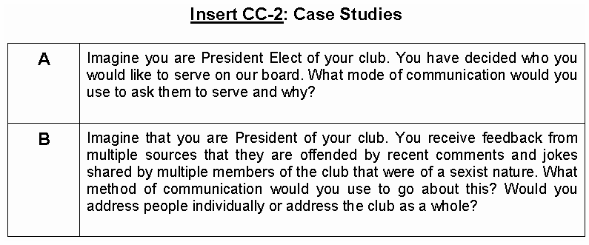
Notes:
Share this to breakouts to allow them to view the cases.

Slide 8

Types of Communication
NAME THEM!
Notes:
Direct the participants to
Identify which type of communication you prefer
Using the blank slide and annotation tools post YOUR PREFERRED type of communication

Slide 9

Types of Communication
Notes:
In Round Robin fashion go around the room having each person offer one tool.
Take three or four examples.

Slide 10

Barriers
Never done it before
Generation gaps
Know it all
Don’t listen
Cliques
Lack of trust
Want all the credit
Notes:
Identify the barriers and problems that exist to effective communication in clubs.
What barriers or problems exist to effective communication in your club?
Discussion might include the following:
Personality clashes
Never done it that way before
Cliques within the club
Generation gaps
Failure to dedicate adequate time for successful communication
Know-it-alls
Not listening
Not delegating
Not trusting
Not willing to share credit
Not leading
Lack of education
As barriers are posed, invite the group to suggest how to overcome them.

Slide 11

New Technology
Notes:
Present the idea of new upcoming technology.
What new technology could be used to expand your Rotary club’s communication efficacy?
Consider the following in reflecting on new technology:
New technology to some may be like speaking a foreign language while to others it is commonplace
Use this question as a brainstorming opportunity that will likely put younger Rotarians and persons with tech backgrounds in more of a teaching and helping role
Allow them to teach each other and network for further help later

